Slide 1
Gamification of Computational Problems
BY
MILIND CHAUHAN IIT2014117
SURESH KUMAR DHAYAL IIT2014060
NAVRATNA SHARMA IIT2013148
Under the supervision of
Dr. Rishi Ranjan Singh
Asst. Professor
IIIT ALLAHABAD

Slide 2
Introduction
The first video game known to be written was Turochamp. It was a chess simulation written by Alan Turing and David Champernowne but it was never implemented
Both the games and the machines they run on have come a long way since then
Nowadays, computers are very accessible. This has allowed a larger audience to be able to play and enjoy video games
It is interesting to note however that many of the popular video games are NP-Hard.

Slide 3
Some Examples
Super Mario Brothers [1]
Tetris [2]
Candy Crush Saga [3]
2048 [4]

Slide 4
Motivation
These games generally have a simple premise
swap tiles to form matches (candy crush)
combine tiles with the same number on it to form tiles with a greater number (2048) etc.
The premise is simple so the game is easy to pick up, but the goal is hard.
For eg: Can you match enough tiles to reach a particular score in candy crush?
Can you combine enough tiles of same number to finally get the tile with the number 2048 on it?

Slide 5
Motivation contd.
It turns out that many of the questions that can be asked about the goals of these games are also NP-Complete (also NP-hard).
For eg: In 2048, given an m x n board, is it possible to obtain a tile of value 2048 is NP-Complete [4],
In candy crush, can a score of ‘s’ or more be achieved in some ‘k’ swaps is NP-Complete [3] and so on.
This makes the study of NP-Hard games interesting. How many more games out there are NP-Hard?
Can a new game be developed based on an NP-Hard problem? These are the question that we wish to seek the answers to in this project

Slide 6
Objective
To analyze already existing NP-Hard games
To study and learn the process of proving games to be NP-Hard
To prove, if we can, a new game, previously unproven to be NP-Hard
To finally propose and build a new game based on an NP-Hard Problem

Slide 7
The First Step
ANALYZING AN NP-HARD GAME

Slide 8
The Classification of Problems
P Class: of problems are those for which a polynomial time solvable algorithm exists. For eg: Sorting
NP Class: of problems are those which are polynomial time verifiable, i.e. Given an NP problem and solution to the problem you can easily verify if the solution is correct or not in polynomial time. Note that P class is a subset of NP , since one way to verify the solution is to find the solution and match them
NP Hard: A problem is NP-Hard if it is at least as “hard” as all the problems belonging to the NP class
NP Complete: A problem is said to be NP-Complete if it is both NP and NP-Hard

Slide 9
Polynomial Time Reducibility
A problem A is said to be reducible to another problem B if there exists a polynomial time transformation that transforms an instance of the problem A into an instance of the problem B.
Reducibility is useful because it helps us find out the “hardness” of a problem in terms of another of which we already know the “hardness” of.
This means that if there is an efficient polynomial time algorithm to solve B then then we also have an efficient polynomial time algorithm to solve A, since all we have to do is reduce the instance of A into an instance of B in polynomial time and then apply B’s polynomial algorithm
This is useful in proving problems to be NP-Complete. If one can reduce an NP-Complete problem to another problem say X. Then X also has to be NP-complete.

Slide 10
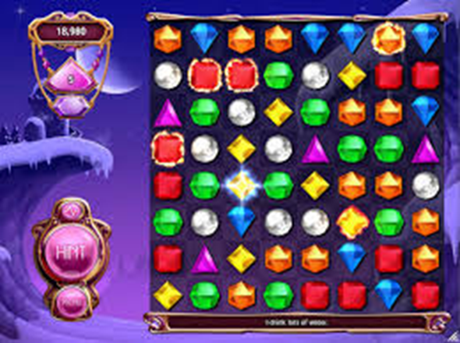
The Case of BEJEWELED

Slide 11
The Case of BEJEWELED
Bejeweled is a popular tile matching match-3 type game
It consists of an 8 x 8 board filled with 6 different gems, which we’ll denote using A, B, C, D, E and F
Each gem is considered adjacent to the gems directly North, South, East and West of it.
The player can swap a gem with it’s adjacent gem if it results in the alignment of 3 gems of the same type either vertically or horizontally
The matched group then “pops” out (or deletes) itself leaving an empty space, which the gems above them fall down to fill.
If multiple matches form due to one swap, all the matches are popped out

Slide 12
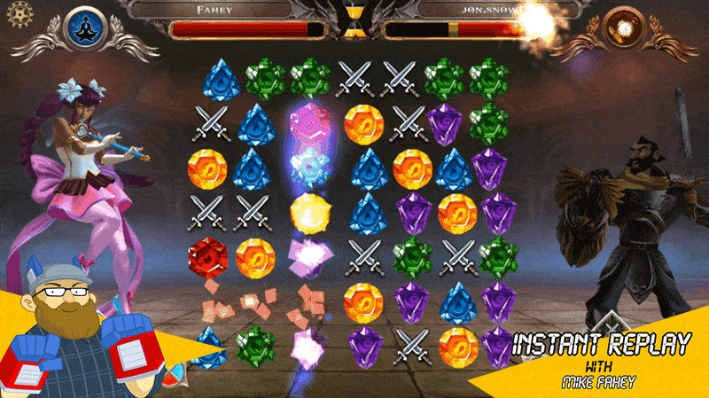
The Case of BEJEWELED

Slide 13
Reduction Overview
The Reduction is of an instance of 1in3 Positive 3Sat (1in3PSAT) which is NP-Hard problem [5] with ‘n’ literals and ‘m’ clauses into with the goal of satisfying the clauses such that each clause has exactly one literal set to the value of TRUE into an instance of a generalized case of BEJEWELED with a board of w x h with goal of popping out a specific gem ( goal gem ).

Slide 14
Reduction
There are a total of six gadgets:
The Sequencer
The Choice Activator
The Choice Wire
The Displacer
The Automatic Wires
The Goal Wire

Slide 15
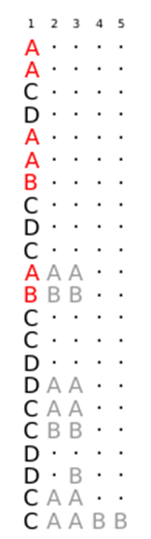
The Sequencer
The first column in its entirety is the sequencer gadget. It has two main functions:
Passing the control from one variable to next.
Activating the displacers and the automatic wires.
In the figure, the parts in red are the parts that will activate the wires by coming in contact with them and forming a match and thus popping out. The parts in grey are example gadgets that do nothing except interact with the sequencer

Slide 16
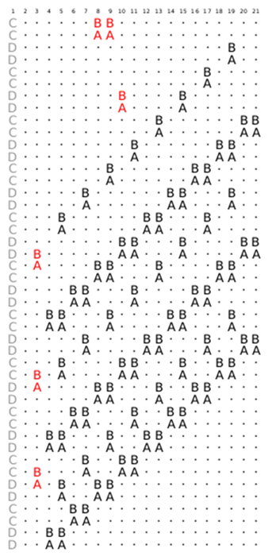
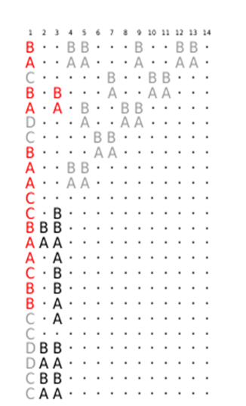
The Choice Wire (And Activator)
Whenever you set the choice activator for a variable to TRUE, the choice wire is set in such a way that it get it’s popped out in its entirety via a set of consecutive matches.
Each clause is represented by a set of three consecutive columns the locations of which are represented by the formula: (2*j + 6, 2*j + 8), where j = 1 for the first clause and so on

Slide 17
The Choice Wire (And Activator) cont.
The gadgets ensure that all rows fall by a number that is a multiple of six, while the clauses columns have extra gems for the literals they contain. If the clause is satisfied by the assignment of its literals, those extra gems match up to make the clause columns fall by 2 extra rows and line up with the goal line.
If all the clauses are satisfied then the goal line becomes complete and then it is easy to pop the goal gem.
Hence an instance of 1-in-3 positive SAT problem is reduced to an instance of the bejeweled problem of popping a specific gem.

Slide 18
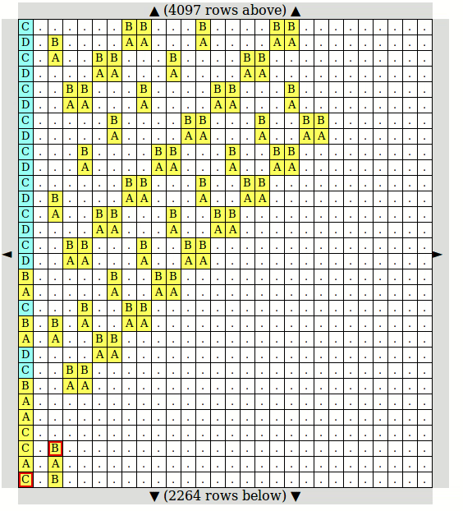
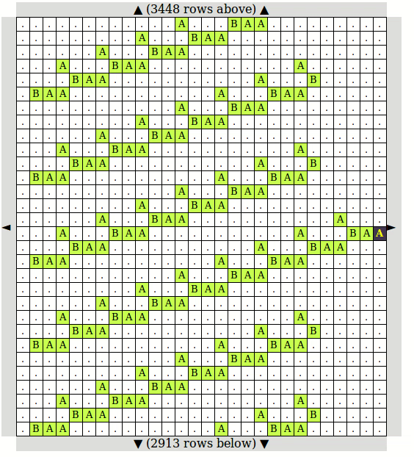
Working of the Choice Wire (And Activator)
Setting the literal to TRUE [6]
The goal wire when the clause is satisfied [6]

Slide 19
Result
The reduction process reduces an instance of 1in3PSAT problem into an instance of Bejeweled.
1in3PSAT is a NP-Hard Problem [5]
Hence the problem of popping a specific goal gem is also NP-Hard.

Slide 20
References
[1] G. Aloupis; E. D. Demaine; A. Guo. "Classic Nintendo Games are (NP-)Hard". arXiv:1203.1895, 3 sept 2012.
[2] Eric D. Demaine; Susan Hohenberger; David Liben-Nowell. “Tetris is Hard, Even to Approximate”. Proceedings of the 9th International Computing and Combinatorics Conference (COCOON 2003). Big Sky, Montana, July 25–28, 2003
[3] Toby Walsh. “Candy crush is np-hard”, arXiv preprint arXiv:1403.1911, 2014
[4] Ahmed Abdelkader et al., “2048 is NP-Complete”, CG:YRF, Eindhoven, The Netherlands, June 22-25, 2015
[5] Michael R Garey and David S Johnson. “Computers and intractability”, volume 174. freeman San Francisco, 1979

